Slide 1
Digital Thinking and Innovation
Digital Culture and Society

Slide 2
Recap Topic 1 – Digital Generation
Define/Describe Agile Thinking

Slide 3
Recap Topic 1 – Digital Generation
Define/Describe Agile Thinking
Ans: Agile Thinking is the way of thinking which enables the ability to respond to change or solve problems quickly and easily
Take everything as lessons
Adjust actions according to the feedback
Proceed toward desired outcomes, resulting in continuous improvement

Slide 4
Recap Topic 1 – Digital Generation
Define/Describe Digital Thinking
Define/Describe Digital Literacy

Slide 5
Recap Topic 1 – Digital Generation
Define/Describe Digital Thinking
Ans: The variety of thinking skills that comprise digital literacy.
Define/Describe Digital Literacy
Ans: An individual's ability to find, evaluate, and compose clear information through writing and other media on various digital platforms

Slide 6
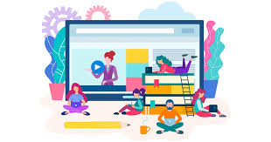
Introduction
This topic discusses how technology promotes culture change towards the digital world, which ultimately leads to the digital society.

Slide 7
Learning Outcomes for the Lecture
At the end of this lecture, you will be able to:
Explain culture change
Understand the evolution to digital world (digital culture)
Understand the impacts of digital culture to the society (digital society)

Slide 8
Content
Culture Change
Digital Culture
Digital Society

Slide 9
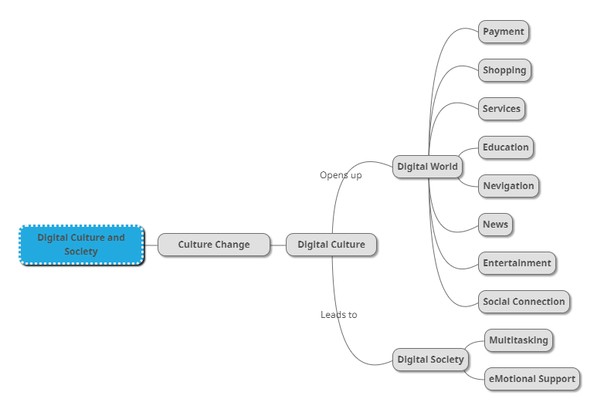
Mind Map

Slide 10
Learning Outcomes for the Lecture
At the end of this lecture you will be able to:
Explain culture change
Understand the evolution to digital world (digital culture)
Understand the impacts of digital culture to the society (digital society)

Slide 11

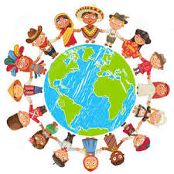
Culture is symbolic communication and acceptance by the community.
Definition: A way of life of a group of people– the behaviors, beliefs and values that they accept without thinking much about them, and that are passed along by communication and imitation from one generation to the next.

Slide 12
What is culture change?
Culture Change
technology in culture
Cultural change can occur from within through new philosophical ideas or technological advancement.
Technology is changing every aspect of our lives. The benefits provided by new digital approaches are having a huge impact on our societies. Many facets of global communications today are influenced by cultural differences – be it email, Skype, social media or the telephone.
Why these changes happened?

Slide 13

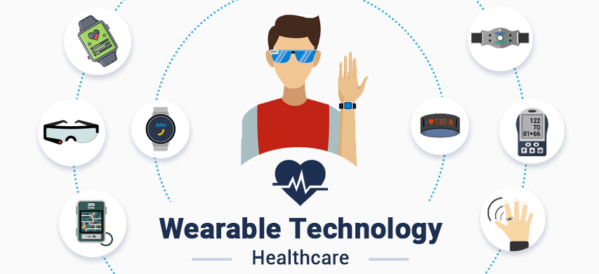
Technology Promotes Culture Change
Technology today has changed the way people do just about everything – from shopping and researching to getting the news and accessing healthcare
Radio and television have evolved into streaming services and can be accessed 24 hours a day
Wearable technology is now available
Monitoring steps and activity through a fitness tracker
GPS tracker for children and elderly
https://www.youtube.com/watch?v=HfL7WzKiXm4

Slide 14
Learning Outcomes for the Lecture
At the end of this lecture you will be able to:
Explain culture change
Understand the evolution to digital world (digital culture)
Understand the impacts of digital culture to the society (digital society)

Slide 15

Impact on Culture
Digital Culture:
Payment
Shopping
Services
Education
Navigation
News
Entertainment
Social Connection
What was before the changes?

Slide 16










Digital Culture
A digital culture is a concept that describes how technology and the internet are shaping the way that we interact as humans. It’s the way that we behave, think and communicate within society. A digital culture is the product of the endless persuasive technology around us and the result of disruptive technological innovation.
10 companies with a digital culture
CLICK ME

Slide 17
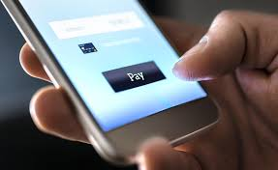

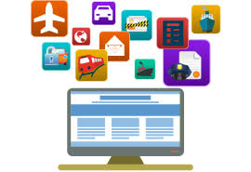
Digital Culture
Payment:
PayPal, Apple Pay, Google Pay, WeChat Pay, Touch 'n Go eWallet
Shopping:
Online Shopping ranging from clothes to electronics, and to food; Lazada, Shopee, eBay
Services:
eMedicine, MyEG, Online Legal Services

Slide 18

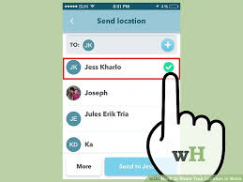
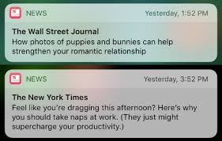
Digital Culture
Education:
Blended Learning, Online Distance Learning
Navigation:
GPS + Social Media = Waze: Uses crowdsourcing and other integrated social features to provide navigation
News:
Breaking news alert through push notification

Slide 19
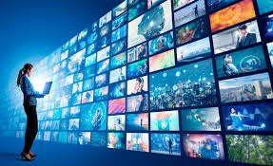
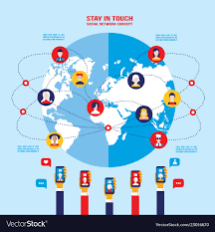
Digital Culture
Entertainment:
DIY hacks, for a good laugh, music and movies are all readily available; YouTube, Netflix, Spotify
Social Connection:
Snapchat, Instagram, Facebook, Twitter, Reddit and other online communities

Slide 20
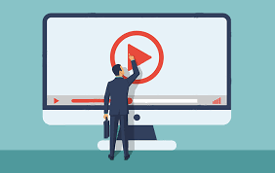
Group Discussion
Watch and discuss the content of the video:
https://www.youtube.com/watch?v=xBQQ1dQ_2Ow

Slide 21
Learning Outcomes for the Lecture
At the end of this lecture you will be able to:
Explain culture change
Understand the evolution to digital world (digital culture)
Understand the impacts of digital culture to the society (digital society)

Slide 22
The Digital Society
Engaging in the digital world has become an integral part of life.
However, a delicate tipping point between the benefits of unlimited content/connection and overuse/dependency.
Generation Z’s perspectives and behaviors are shaped by the technology used– for better and for worse.

Slide 23
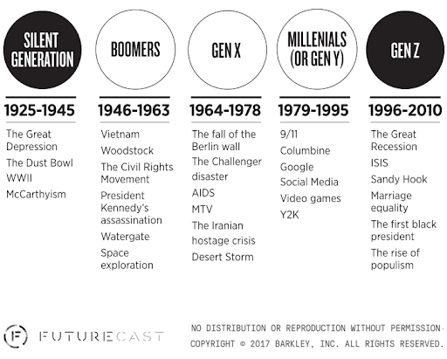
The Digital Society
A Digital Society is an interdisciplinary research area and a kind of progressive society that has been formed as a result of adaptation as well as integration of advanced technologies into the society and culture

Slide 24
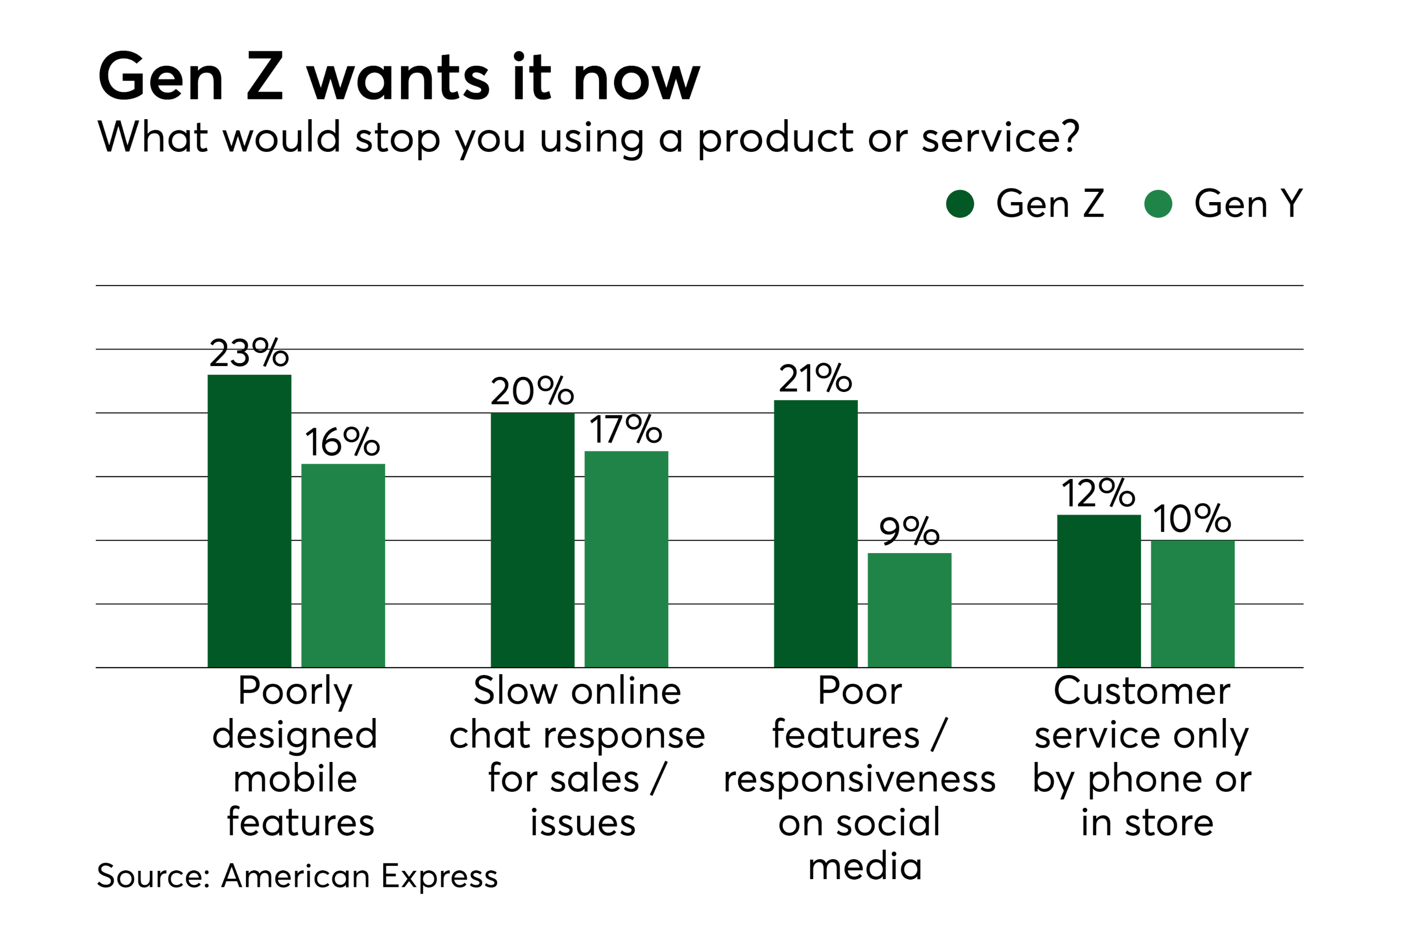
Let’s discuss…

Slide 25

The Digital Society
Researchers found that “70% percent of younger Millennials and older members of Generation Z have their phone within arm’s reach when they sleep, and more than half check their phones if they happen to wake up sometime during the night.” – A study by LivePerson

Slide 26

The Digital Society
Another study found that 18 to 24 year-olds check their phones “86 times a day, which is higher than any other age group… With 89 percent of Generation Z teens utilizing the Internet multiple times a day” – Deloitte (2017).

Slide 27
The Digital Society
Widespread access and use of digital technology today: Potential for dependency and addiction is a real concern
Digitally native and digitally dependent
Very unlikely Gen Z will disconnect from the online world with ease
Not easily swayed by monetary rewards: 43% under the age of 35 would “give up their smartphone forever if they were paid to do so, but only to the tune of $5 million” - LivePerson

Slide 28
The Digital Society
Digitally native a person who has grown up in the digital age, (rather than having acquired familiarity with digital systems as an adult, as a digital immigrant).
Digital dependency can be defined as the overuse of the internet or electronics to the point that one's daily life is affected.

Slide 29

Multitasking Across Multiple Devices
2/3 of Gen Z are engaged on multiple devices at one time
Others may argue: Multitasking leads to decreases in the filtering of irrelevant or incorrect information
More than half of Gen Z do not feel that multitasking negatively impacts the quality of their work

Slide 30
Group Discussion
Watch and discuss the content of the video:
https://www.youtube.com/watch?v=hEPCTFuuqgY

Slide 31
eMotional Impact and Support
The identities of many in Gen Z are intertwined with their online lives impacting the emotional health
The digital technology offers a venue to connect with others for emotional support
Pew Research Center found nearly 70% of Gen Z “had received support on social media while dealing with a challenge or going through a tough time”
http://www.im-in-crisis.org/
https://www.vibrant.org/what-we-do/call-text-chat-online-services/

Slide 32
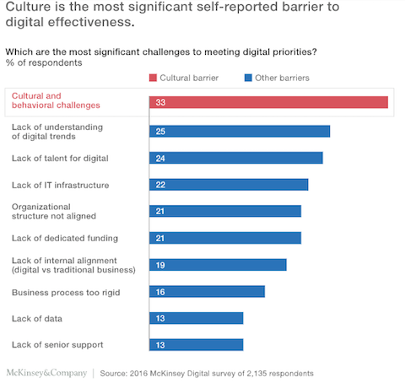
Let’s discuss…

Slide 33
Summary
Culture Change
Digital Culture
Digital Society
eMotional Support

Slide 34
Questions and Answer
Q & A

Slide 35
Next Lecture
System Thinking and Organizational Innovation
Please watch this video: https://www.youtube.com/watch?v=9bYpk75JnZU

